Slide 1


Obesità e Reflusso: Fisiopatologia e Definizioni
Salvatore Tolone MD, PhD, FACS
Associate Professor of Surgery
General, Mininvasive, Oncological and Bariatric Surgery Unit
(Chief: Prof L. Docimo)
salvatore.tolone@unicampania.it
Venice May 13th 2025

Slide 2
Speaker Declarations
Prof. Tolone has following relationships with industry
Personal payments/honoraria/fees:
  none
Research grants
  Italian PNRR
Equipment grants
  none
Educational events:
  none
The content of this talk has not been influenced by any sponsors

Slide 3
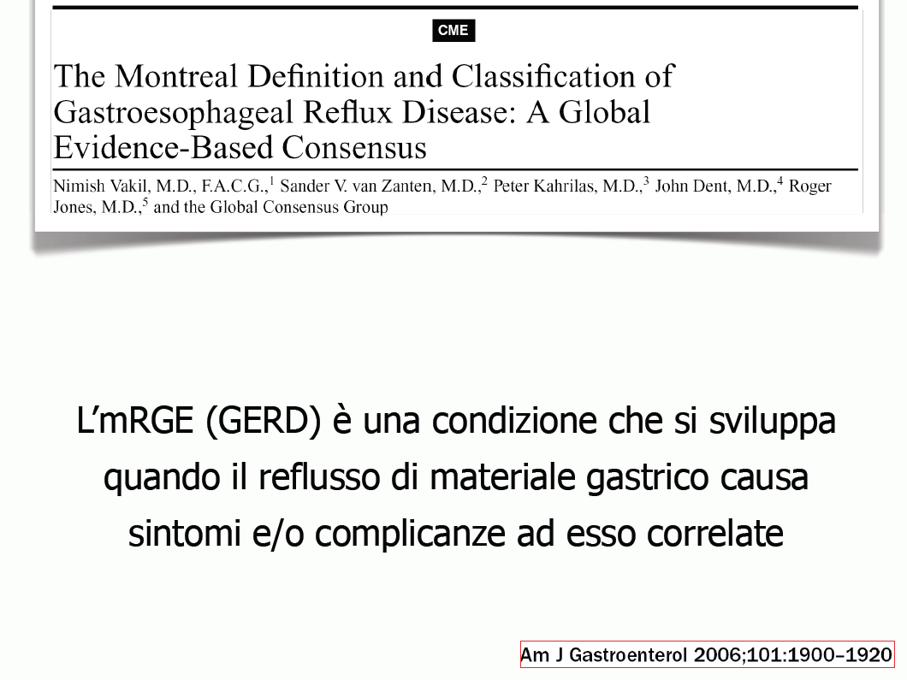
the GERD is a chronic condition that develops when the reflux of gastric material into the esophagus causes symptoms and / or complications

Slide 4
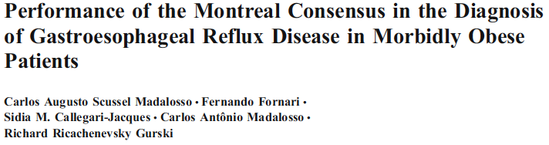
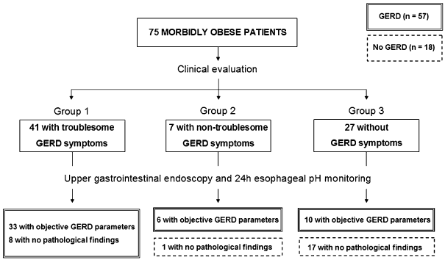

Slide 5
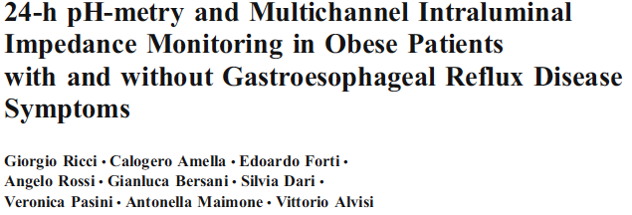
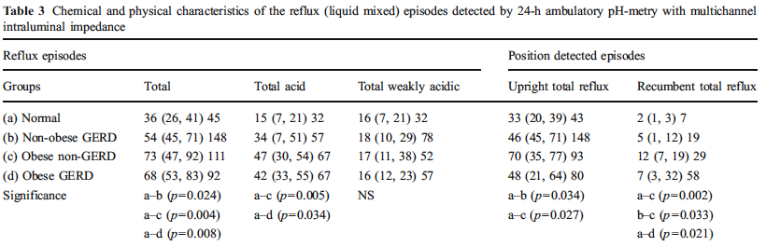
Same reflux exposure in obese with or without symptoms

Slide 6
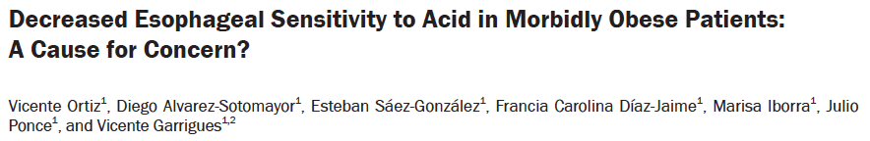
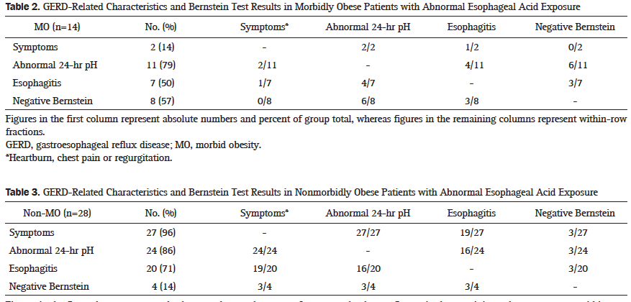

Slide 7
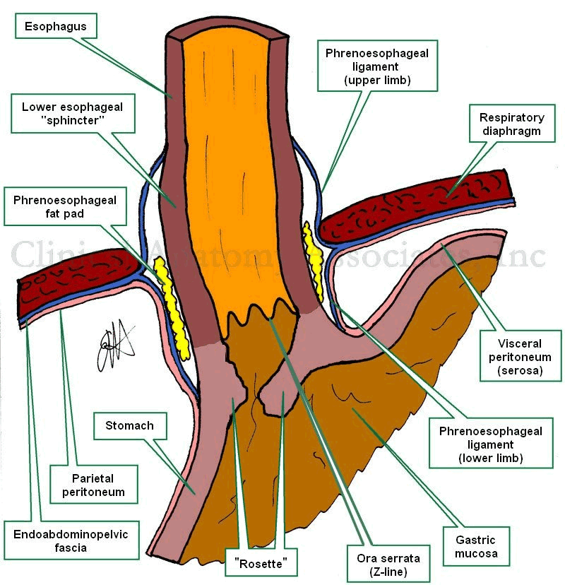

Slide 8

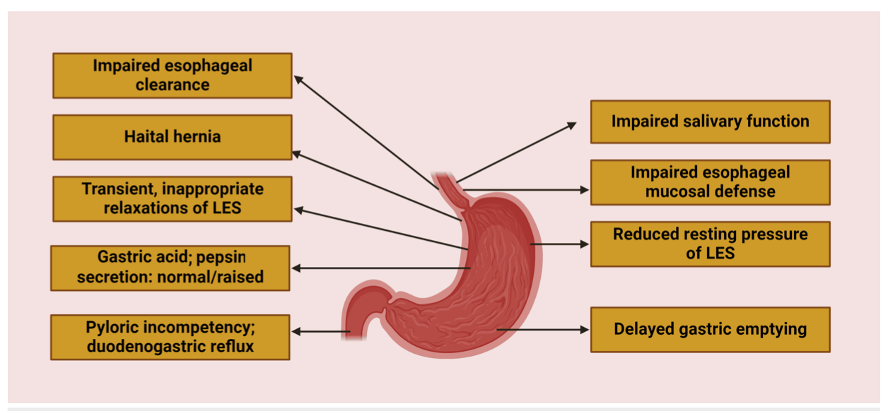
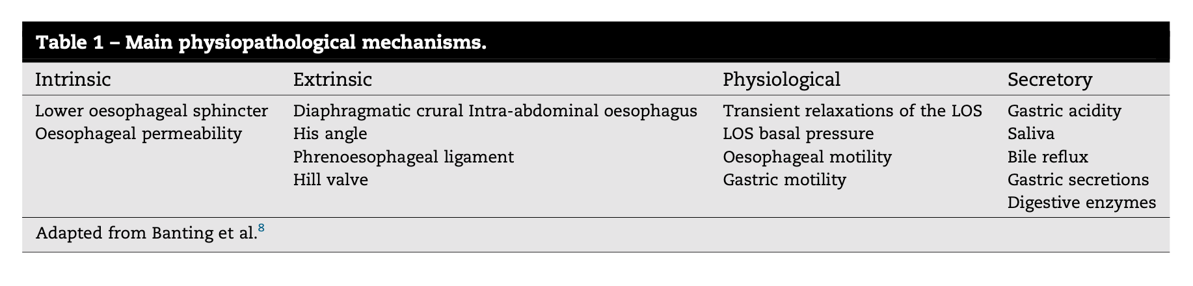

Slide 9

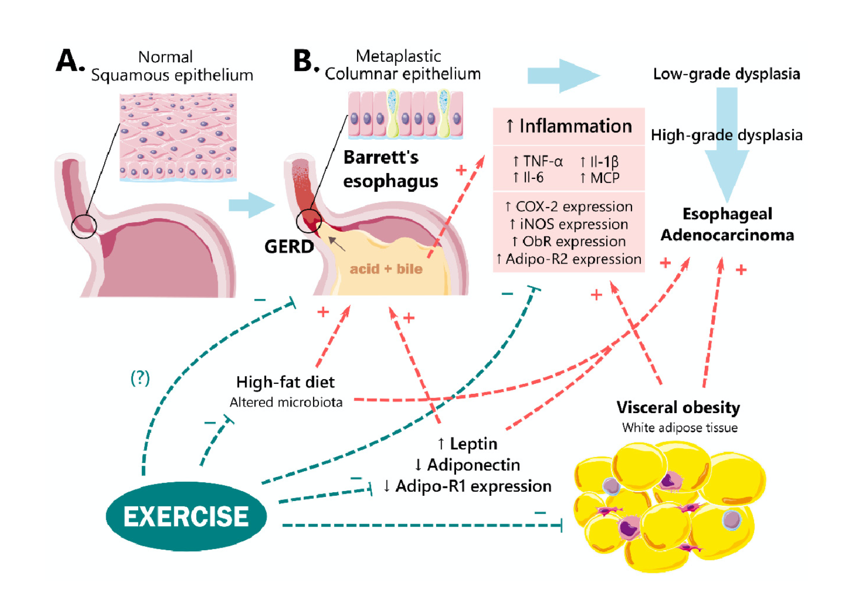

Slide 10


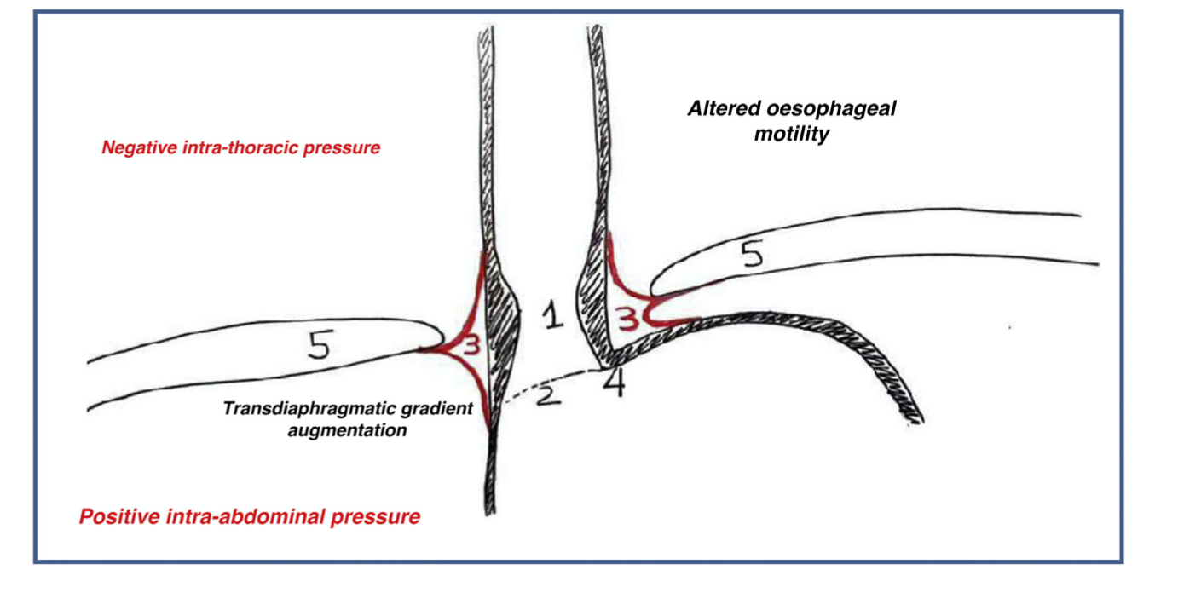
Elevated leptin – Increased GERD Severity
Lower ghrelin –decreased severity
CCK linked to fat diet – increased Tlesrs
Fat diet and carboneted drink – gastric delayed emptying
Diabetes – motility disorders
OSAS – change in thoracic and abdominal pressures
Increased GEPG

Slide 11
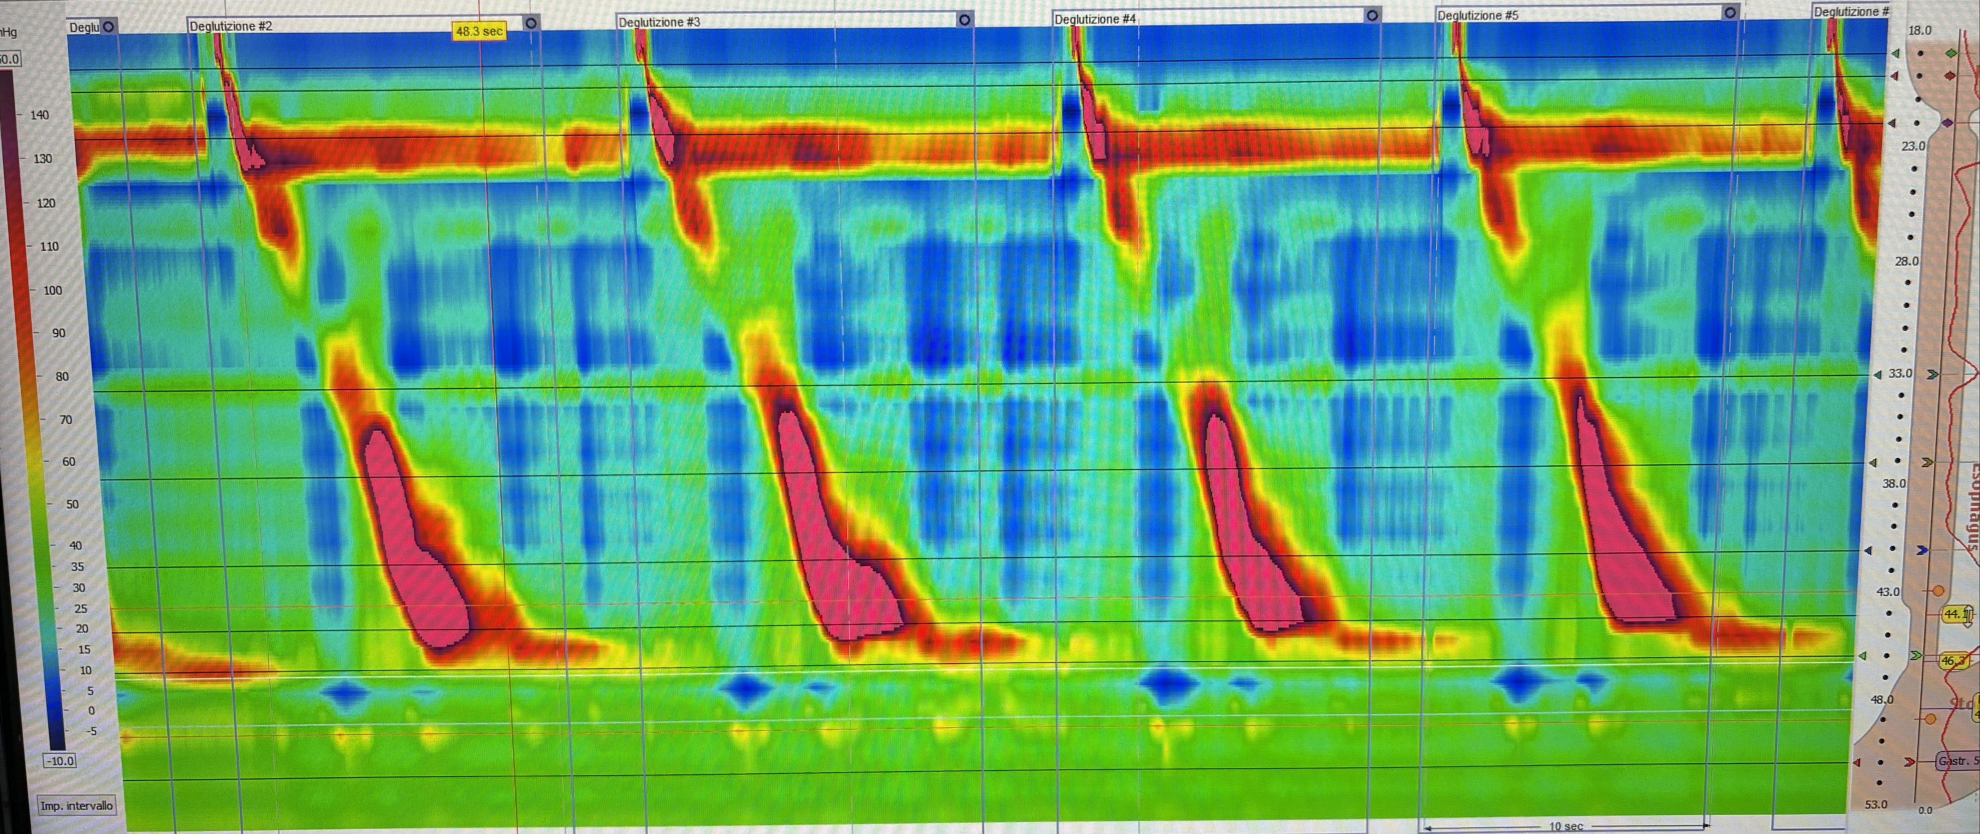
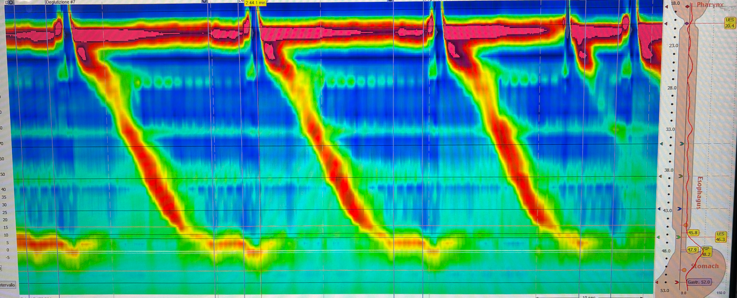
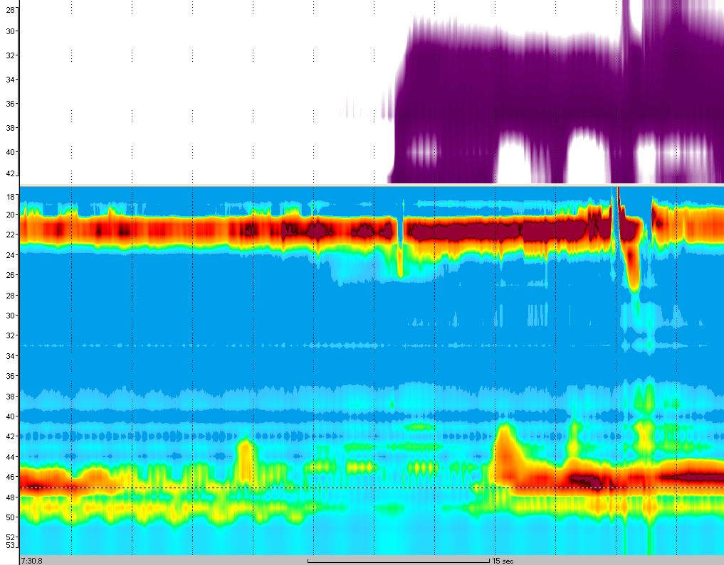
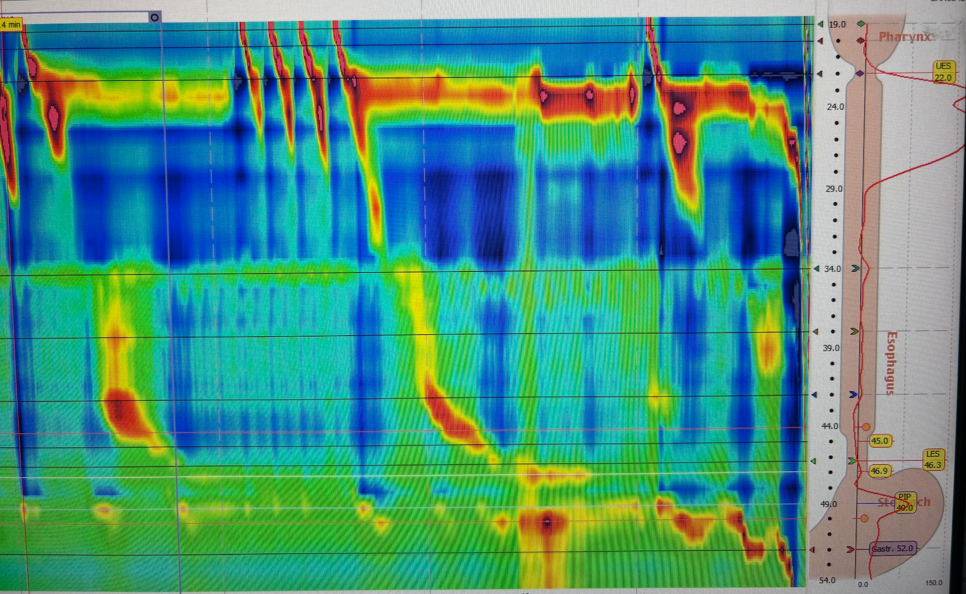

Slide 12
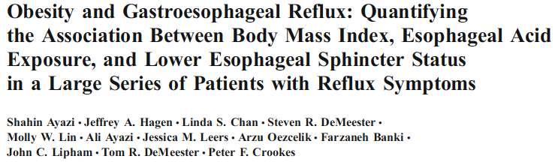
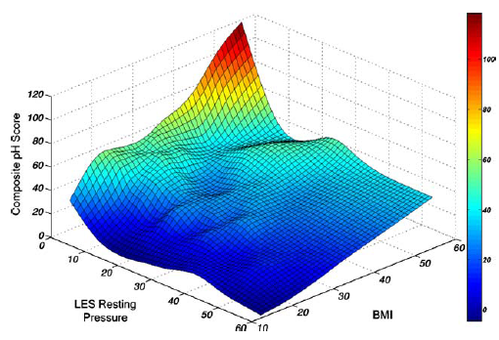
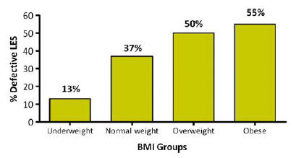
Obesity is a strong independent risk factor of gastroesophageal reflux disease (GERD), esophagitis and hiatal hernia development.
1659 pz
Notes:
Obesity is currently considered an epidemic condition. Furthermore, Obesity is a strong independent risk factor of gastroesophageal reflux disease (GERD), esophagitis and hiatal hernia development. It is currently demonstrated, as showed in this large series, that there is an inverse correlation between BMI and LES pressure, and a direct correlation between BMI and acid exposure.

Slide 13
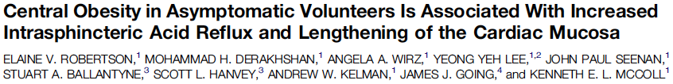

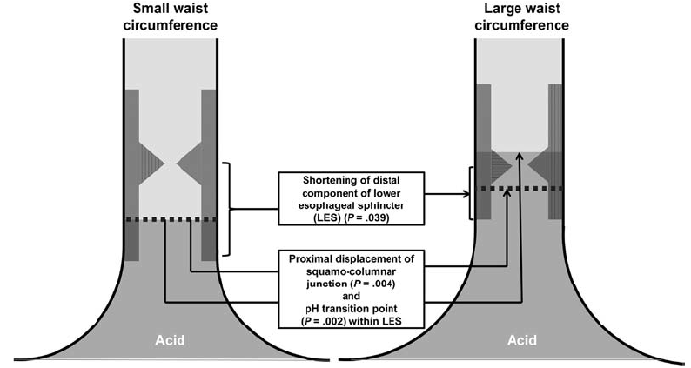
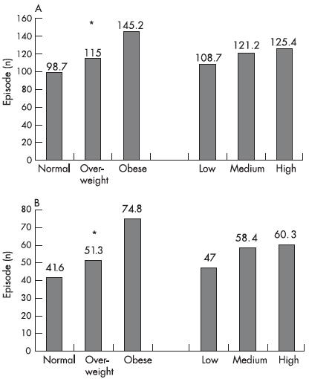
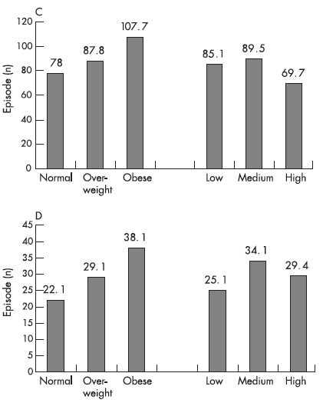

Slide 14
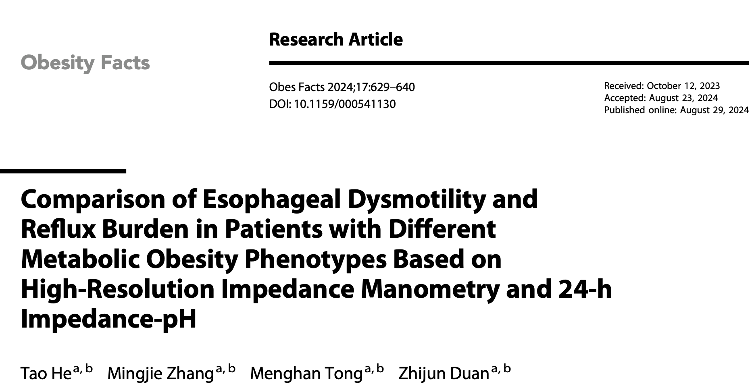
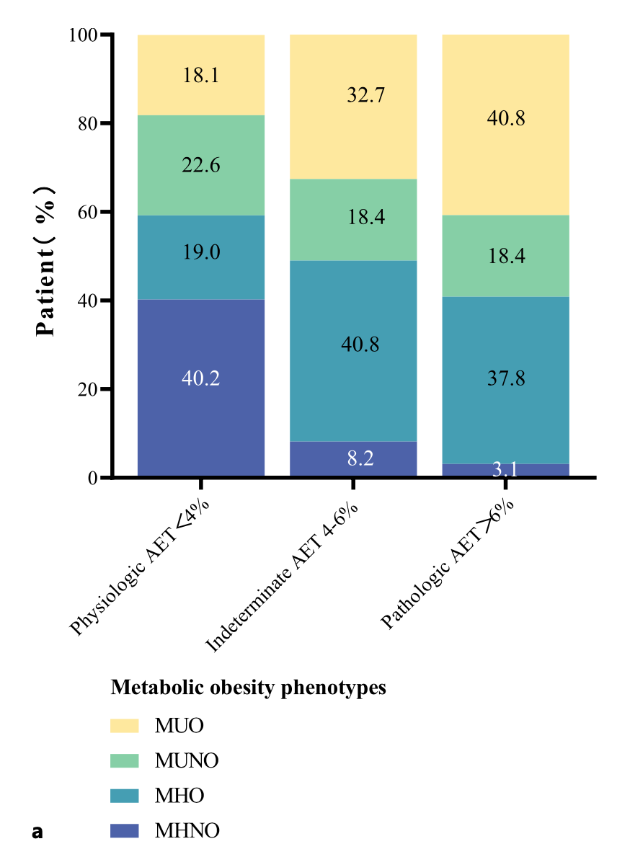
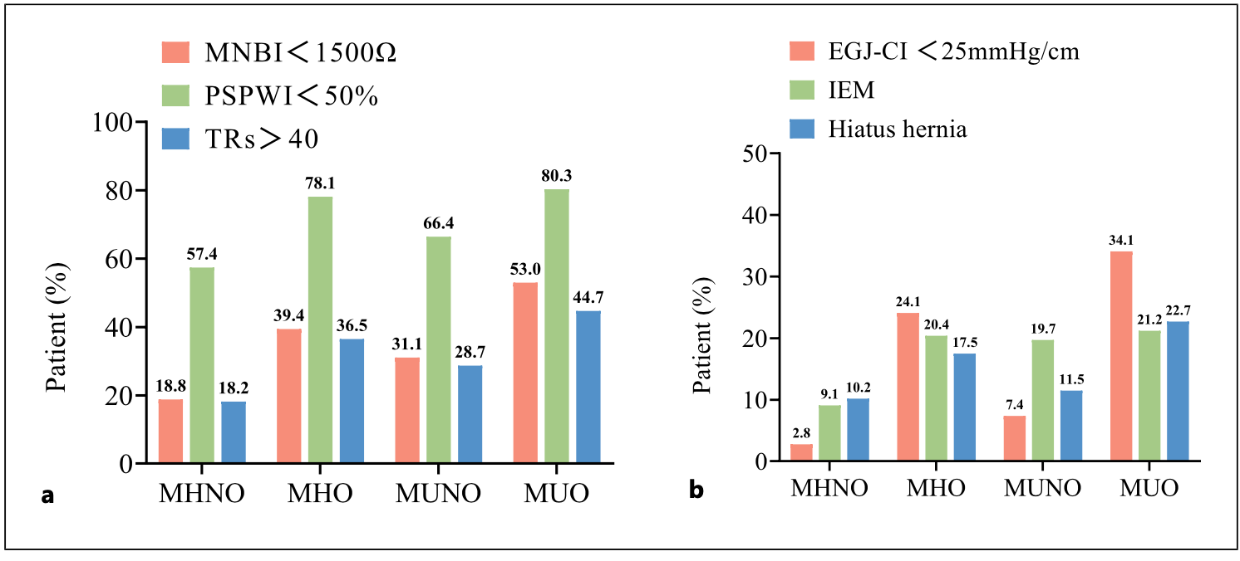
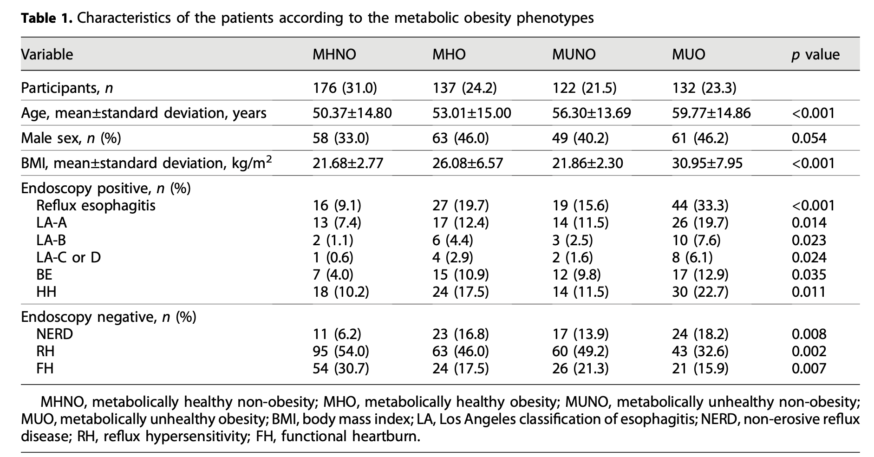
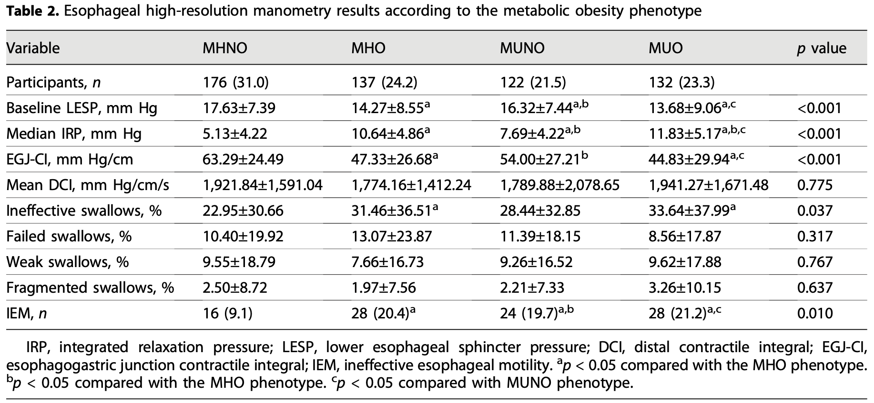

Slide 15
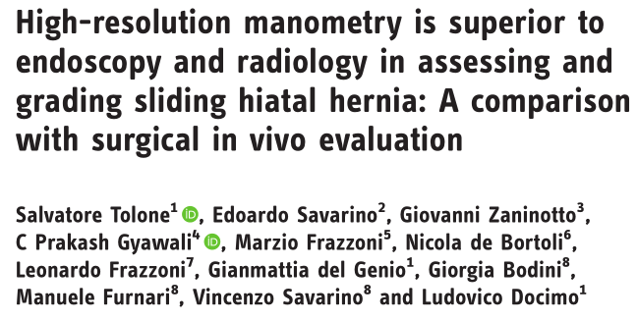
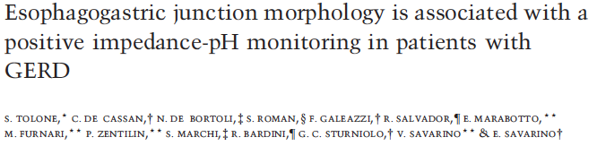
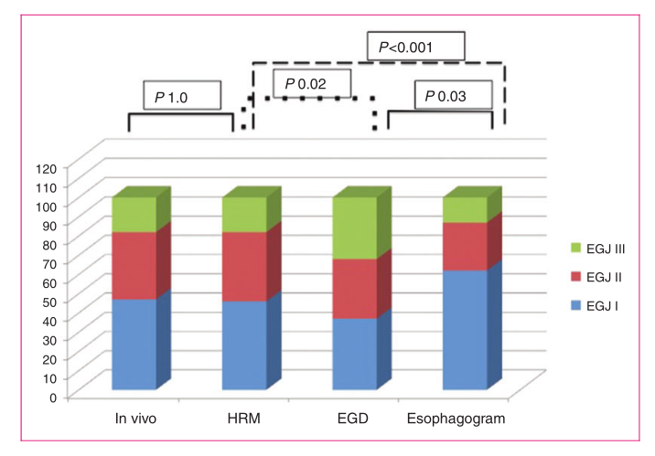
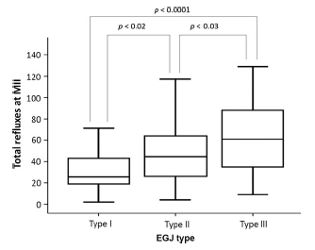
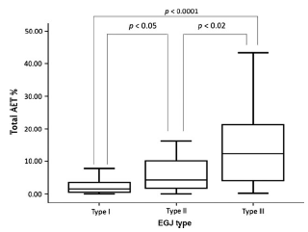
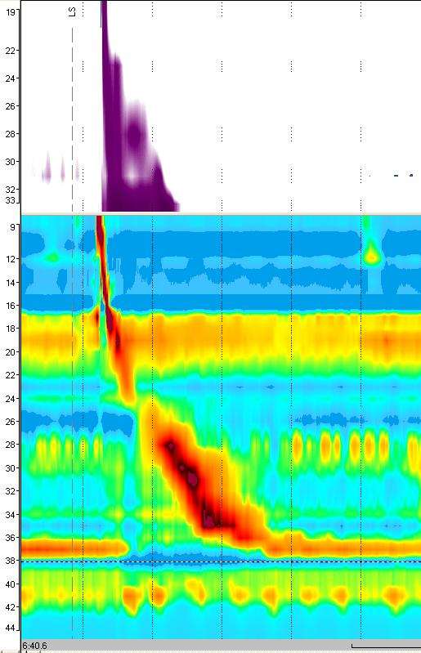
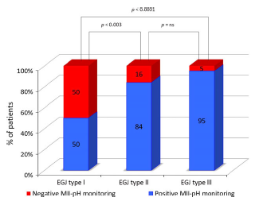
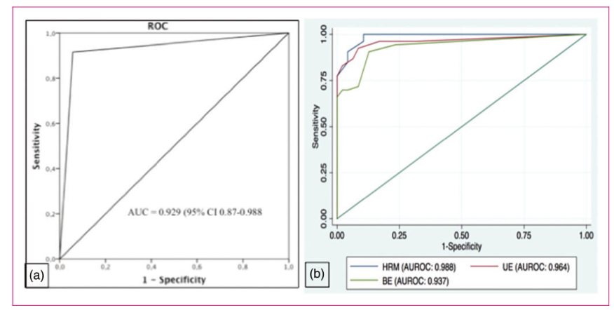
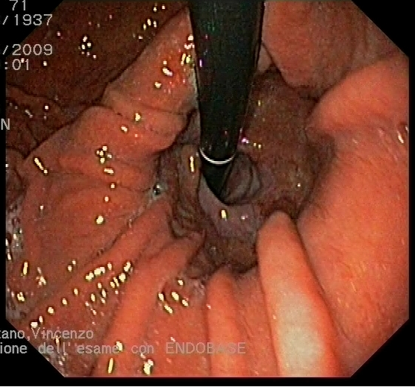

Slide 16
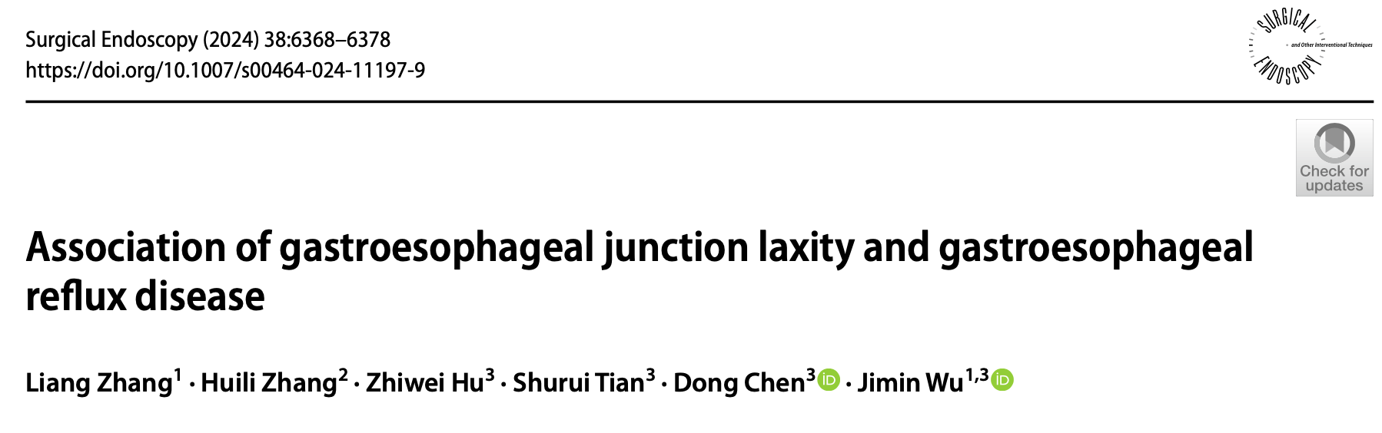
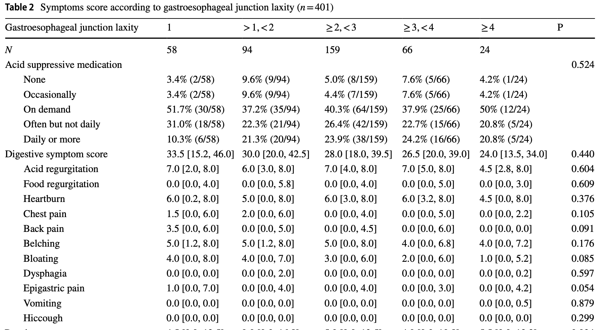
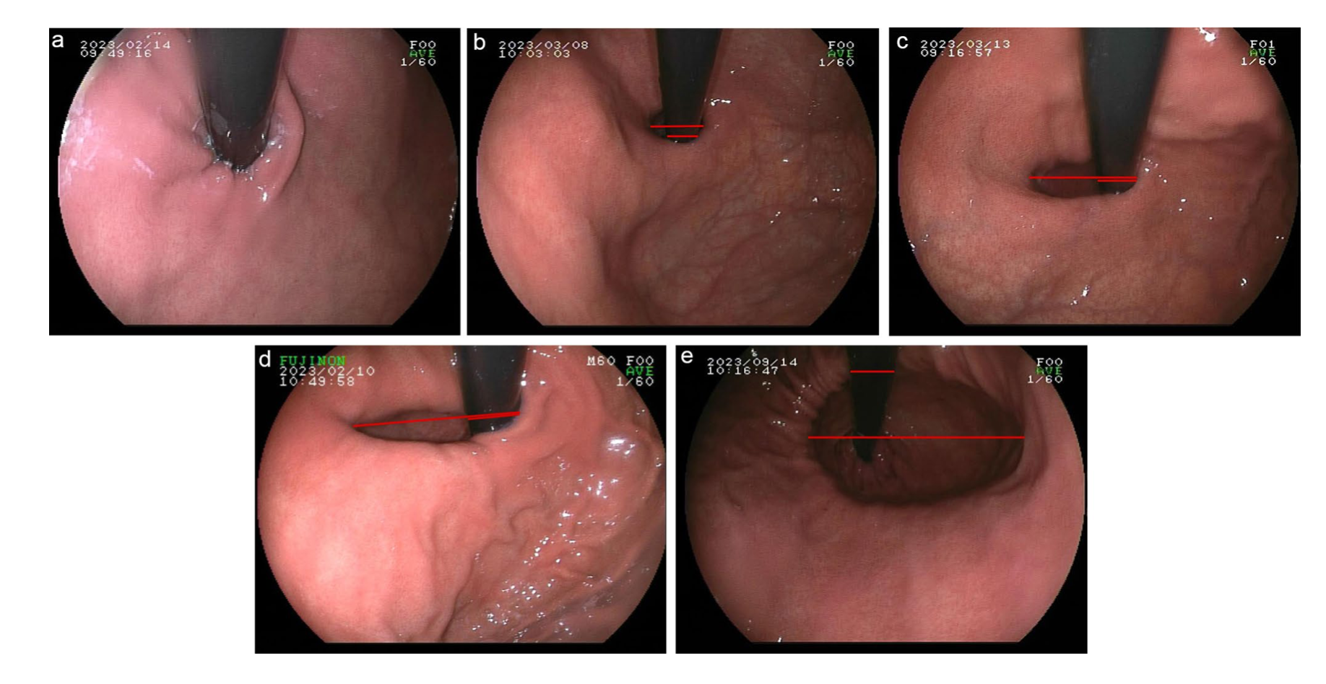
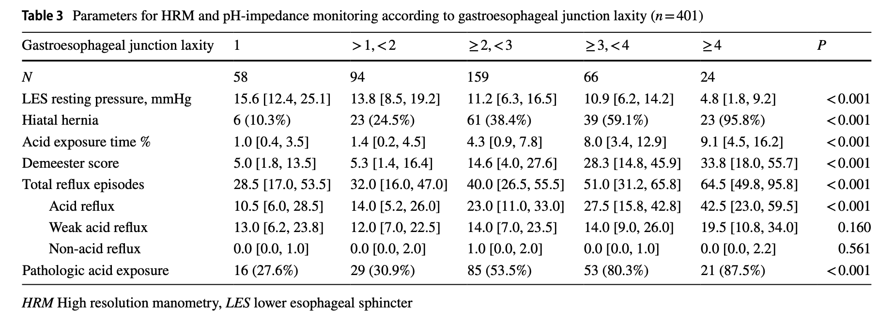
La lassità del diaframma correla con la severità del reflusso ma non con la presenza dei sintomi

Slide 17

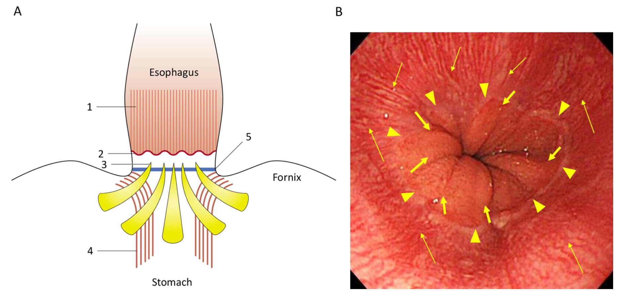
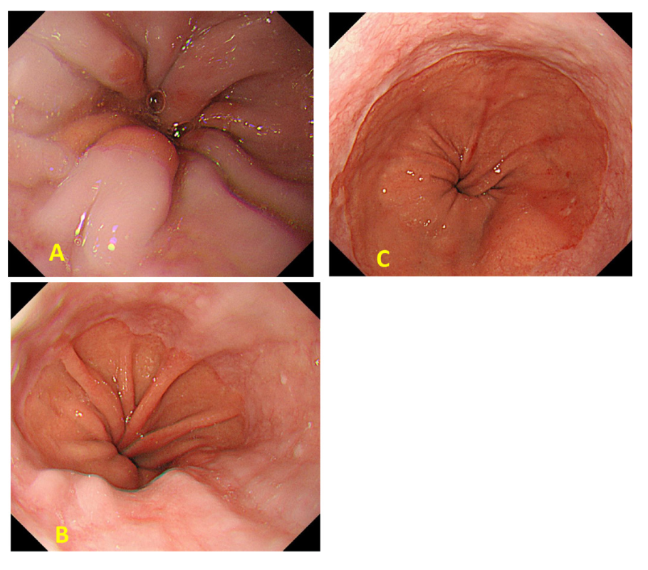
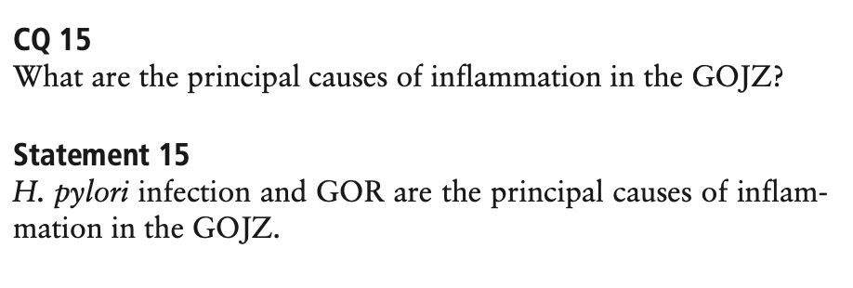
Identificazione dei vasi a palizzata e della prima plica gastrica. Attenzione alla valutazione con insufflazione

Slide 18
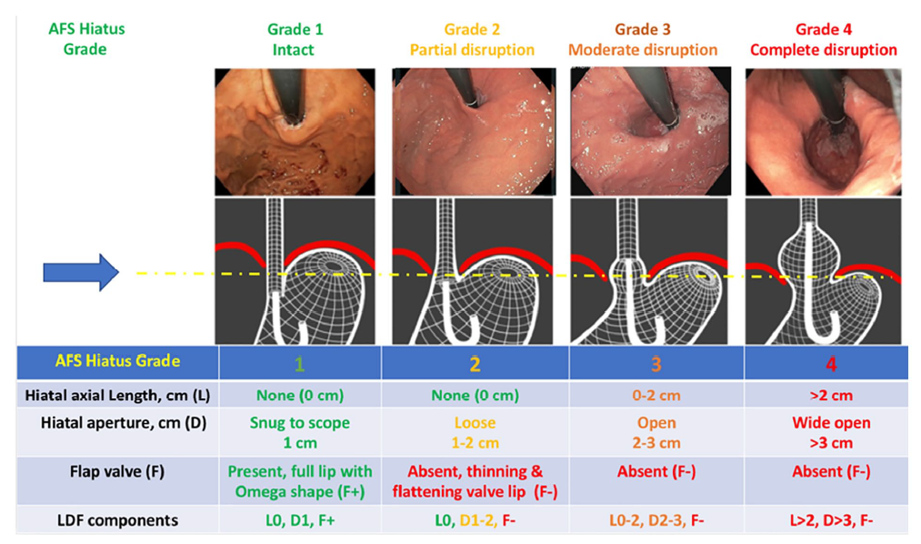
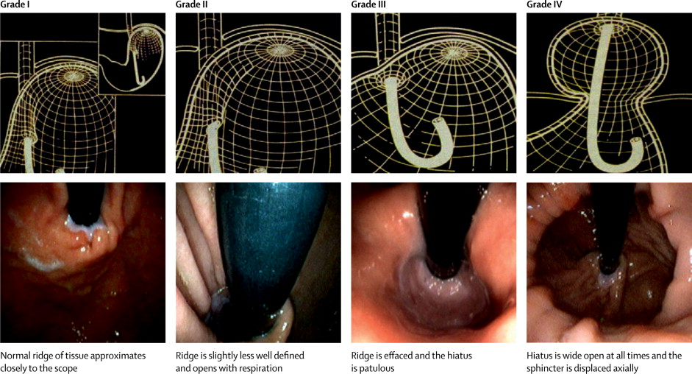
Diagnosi di ernia iatale vs. stratificazione rischio MRGE
EGDS
Hill vs. AFS classification
Nguyen et al. The American Foregut Society White Paper on the Endoscopic Classification of Esophagogastric Junction Integrity, Foregut 2022

Slide 19
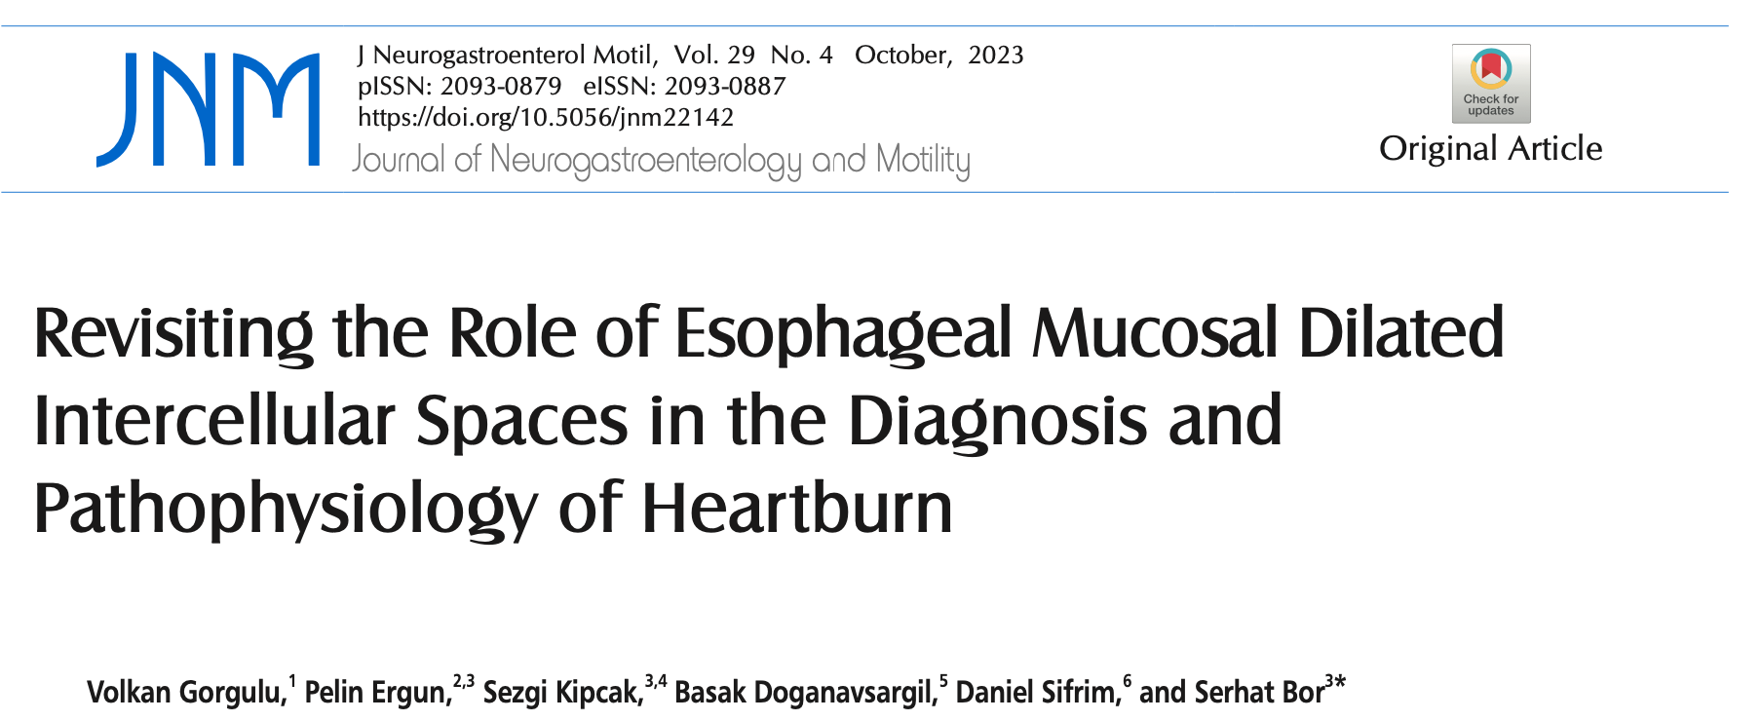
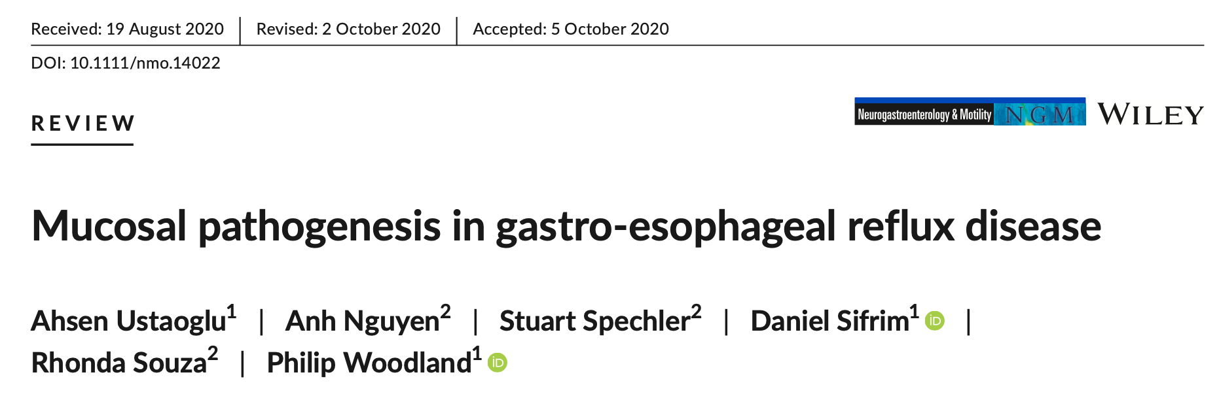
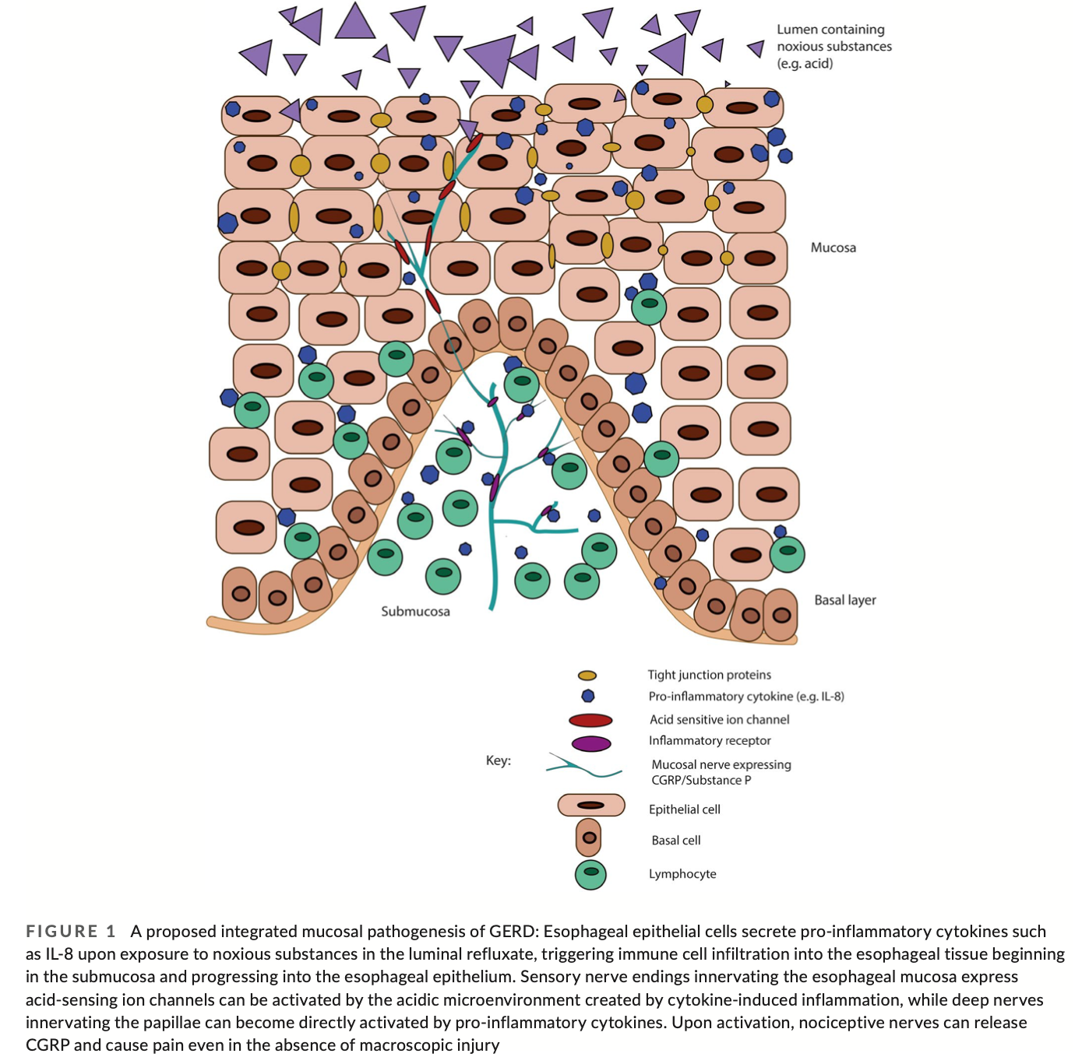
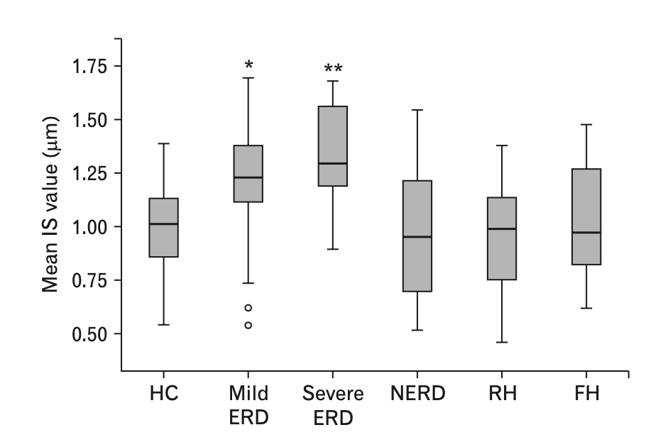

Slide 20




Slide 21

LA Grades of Esophagitis
LA Grade A
LA Grade B
Lundell et al, Gut 1999;45:172-80
155 patients
74 with LA grade A
61 with LA grade B
20 with LA grade C
Median AET (%): 1.35 (0.32-3.8) 6.0 (5.2-7.0) 8.7 (5.5-14.2)
PPI response: 39% 74% 70%
LA Grade C
LA Grade D
Visaggi P et al, Am J Gastroenterol. 2023 May 1;118(5):794-801
Notes:
Am J Gastroenterol . 2023 May 1;118(5):794-801.
doi: 10.14309/ajg.0000000000002173. Epub 2023 Jan 12.
Ambulatory pH-Impedance Findings Confirm That Grade B Esophagitis Provides Objective Diagnosis of Gastroesophageal Reflux Disease
Pierfrancesco Visaggi ¹ ² , Giulio Del Corso ³ , C Prakash Gyawali ⁴ , Matteo Ghisa ⁵ , Federica Baiano Svizzero ¹ , Delio Stefani Donati ¹ , Arianna Venturini ¹ , Vincenzo Savarino ⁶ , Roberto Penagini ⁷ , Sebastian Zeki ² ⁸ , Massimo Bellini ¹ , Edoardo V Savarino ⁵ , Nicola de Bortoli ¹
Affiliations
PMID: 36633477
DOI: 10.14309/ajg.0000000000002173
Abstract
Introduction: The Lyon Consensus designates Los Angeles (LA) grade C/D esophagitis or acid exposure time (AET) >6% on impedance-pH monitoring (MII-pH) as conclusive for gastroesophageal reflux disease (GERD). We aimed to evaluate proportions with objective GERD among symptomatic patients with LA grade A, B, and C esophagitis on endoscopy.
Methods: Demographics, clinical data, endoscopy findings, and objective proton-pump inhibitor response were collected from symptomatic prospectively enrolled patients from 2 referral centers. Off-therapy MII-pH parameters included AET, number of reflux episodes, mean nocturnal baseline impedance, and postreflux swallow-induced peristaltic wave index. Objective GERD evidence was compared between LA grades.
Results: Of 155 patients (LA grade A: 74 patients, B: 61 patients, and C: 20 patients), demographics and presentation were similar across LA grades. AET >6% was seen in 1.4%, 52.5%, and 75%, respectively, in LA grades A, B, and C. Using additional MII-pH metrics, an additional 16.2% with LA grade A and 47.5% with LA grade B esophagitis had AET 4%-6% with low mean nocturnal baseline impedance and postreflux swallow-induced peristaltic wave index; there were no additional gains using the number of reflux episodes or symptom-reflux association metrics. Compared with LA grade C (100% conclusive GERD based on endoscopic findings), 100% of LA grade B esophagitis also had objective GERD but only 17.6% with LA grade A esophagitis ( P < 0.001 compared with each). Proton-pump inhibitor response was comparable between LA grades B and C (74% and 70%, respectively) but low in LA grade A (39%, P < 0.001).
Discussion: Grade B esophagitis indicates an objective diagnosis of GERD.

Slide 22


Slide 23



Slide 24
What is Actionable GERD in 2023?
The modern definition of actionable GERD requires evidence of conclusive reflux-related pathology on endoscopy and/or esophageal physiologic testing in the presence of compatible troublesome symptoms
Troublesome typical symptoms alone are enough for medication trials
Up-front esophageal testing is needed for other symptom categories, in PPI non-responders, prior to invasive GERD management or prior to long term medical management
Typical symptoms: heartburn, esophageal chest pain, regurgitation
Chronic cough and wheezing have a low but potential pathophysiologic relationship to reflux episodes
Hoarseness, globus, nausea, epigastric pain and other dyspeptic symptoms have a low likelihood of pathophysiologic relationship to reflux episodes
The more atypical the symptom, the higher the need for up-front testing before management
Notes:
Review
Gut . 2023 Sep 21:gutjnl-2023-330616.
doi: 10.1136/gutjnl-2023-330616. Online ahead of print.
Updates to the modern diagnosis of GERD: Lyon consensus 2.0
C Prakash Gyawali ¹ , Rena Yadlapati ² , Ronnie Fass ³ , David Katzka ⁴ , John Pandolfino ⁵ , Edoardo Savarino ⁶ , Daniel Sifrim ⁷ , Stuart Spechler ⁸ , Frank Zerbib ⁹ , Mark R Fox ¹⁰ , Shobna Bhatia ¹¹ , Nicola de Bortoli ¹² , Yu Kyung Cho ¹³ , Daniel Cisternas ¹⁴ , Chien-Lin Chen ¹⁵ , Charles Cock ¹⁶ , Albis Hani ¹⁷ , Jose Maria Remes Troche ¹⁸ , Yinglian Xiao ¹⁹ , Michael F Vaezi ²⁰ , Sabine Roman ²¹
Affiliations
PMID: 37734911
DOI: 10.1136/gutjnl-2023-330616
Free article
Abstract
The Lyon Consensus provides conclusive criteria for and against the diagnosis of gastro-oesophageal reflux disease (GERD), and adjunctive metrics that consolidate or refute GERD diagnosis when primary criteria are borderline or inconclusive. An international core and working group was assembled to evaluate research since publication of the original Lyon Consensus, and to vote on statements collaboratively developed to update criteria. The Lyon Consensus 2.0 provides a modern definition of actionable GERD, where evidence from oesophageal testing supports revising, escalating or personalising GERD management for the symptomatic patient. Symptoms that have a high versus low likelihood of relationship to reflux episodes are described. Unproven versus proven GERD define diagnostic strategies and testing options. Patients with no prior GERD evidence (unproven GERD) are studied using prolonged wireless pH monitoring or catheter-based pH or pH-monitoring off antisecretory medication, while patients with conclusive GERD evidence (proven GERD) and persisting symptoms are evaluated using pH-impedance monitoring while on optimised antisecretory therapy. The major changes from the original Lyon Consensus criteria include establishment of Los Angeles grade B oesophagitis as conclusive GERD evidence, description of metrics and thresholds to be used with prolonged wireless pH monitoring, and inclusion of parameters useful in diagnosis of refractory GERD when testing is performed on antisecretory therapy in proven GERD. Criteria that have not performed well in the diagnosis of actionable GERD have been retired. Personalisation of investigation and management to each patient's unique presentation will optimise GERD diagnosis and management.
Keywords: AMBULATORY pH MONITORING; ENDOSCOPY; GASTROESOPHAGEAL REFLUX DISEASE.

Slide 25

Lyon Classification 2.0
Gyawali CP, et al. Gut. 2024 Jan 5;73(2):361-371
Notes:
Review
Gut . 2023 Sep 21:gutjnl-2023-330616.
doi: 10.1136/gutjnl-2023-330616. Online ahead of print.
Updates to the modern diagnosis of GERD: Lyon consensus 2.0
C Prakash Gyawali ¹ , Rena Yadlapati ² , Ronnie Fass ³ , David Katzka ⁴ , John Pandolfino ⁵ , Edoardo Savarino ⁶ , Daniel Sifrim ⁷ , Stuart Spechler ⁸ , Frank Zerbib ⁹ , Mark R Fox ¹⁰ , Shobna Bhatia ¹¹ , Nicola de Bortoli ¹² , Yu Kyung Cho ¹³ , Daniel Cisternas ¹⁴ , Chien-Lin Chen ¹⁵ , Charles Cock ¹⁶ , Albis Hani ¹⁷ , Jose Maria Remes Troche ¹⁸ , Yinglian Xiao ¹⁹ , Michael F Vaezi ²⁰ , Sabine Roman ²¹
Affiliations
PMID: 37734911
DOI: 10.1136/gutjnl-2023-330616
Free article
Abstract
The Lyon Consensus provides conclusive criteria for and against the diagnosis of gastro-oesophageal reflux disease (GERD), and adjunctive metrics that consolidate or refute GERD diagnosis when primary criteria are borderline or inconclusive. An international core and working group was assembled to evaluate research since publication of the original Lyon Consensus, and to vote on statements collaboratively developed to update criteria. The Lyon Consensus 2.0 provides a modern definition of actionable GERD, where evidence from oesophageal testing supports revising, escalating or personalising GERD management for the symptomatic patient. Symptoms that have a high versus low likelihood of relationship to reflux episodes are described. Unproven versus proven GERD define diagnostic strategies and testing options. Patients with no prior GERD evidence (unproven GERD) are studied using prolonged wireless pH monitoring or catheter-based pH or pH-monitoring off antisecretory medication, while patients with conclusive GERD evidence (proven GERD) and persisting symptoms are evaluated using pH-impedance monitoring while on optimised antisecretory therapy. The major changes from the original Lyon Consensus criteria include establishment of Los Angeles grade B oesophagitis as conclusive GERD evidence, description of metrics and thresholds to be used with prolonged wireless pH monitoring, and inclusion of parameters useful in diagnosis of refractory GERD when testing is performed on antisecretory therapy in proven GERD. Criteria that have not performed well in the diagnosis of actionable GERD have been retired. Personalisation of investigation and management to each patient's unique presentation will optimise GERD diagnosis and management.
Keywords: AMBULATORY pH MONITORING; ENDOSCOPY; GASTROESOPHAGEAL REFLUX DISEASE.

Slide 26
Conclusioni
Fisiopatologia del GERD complessa, il paziente con obesità è a rischio per forme più severe, ma allo stesso tempo meno sensibile nella mediazione del sintomo.
La diagnosi di GERD deve essere oggettiva
Le definizioni esistono, magari imperfette, perché non le usiamo anche in MBS?

